Slide 1
GeoDesign

Slide 2
What is Geodesign
GeoDesign is combining data, knowledge, and geography to design projects
It solves problems by getting combining data to make informed decisions and from that projects are better able to answer questions, have sustainable designs, and reduced costs for construction
Can be described as 6 questions

Slide 3
The 6 Geodesign Questions
How should the geo-scape be described?
How does the geo-scape operate?
Is the geo-scape working well?
How might the geo-scape be altered?
What differences might the changes cause?
Should the geo-scape be changed?

Slide 4
Geodesign Framework

Slide 5
Using Geodesign with Stakeholders

Slide 6
Geodesign and its Growth
Recently there has been a move to have Geodesign everywhere.
The 2009 ESRI User Conference’s theme was Designing Our Future
There is even a specialty conference called the Geodesign Summit that has been going on since 2009

Slide 7
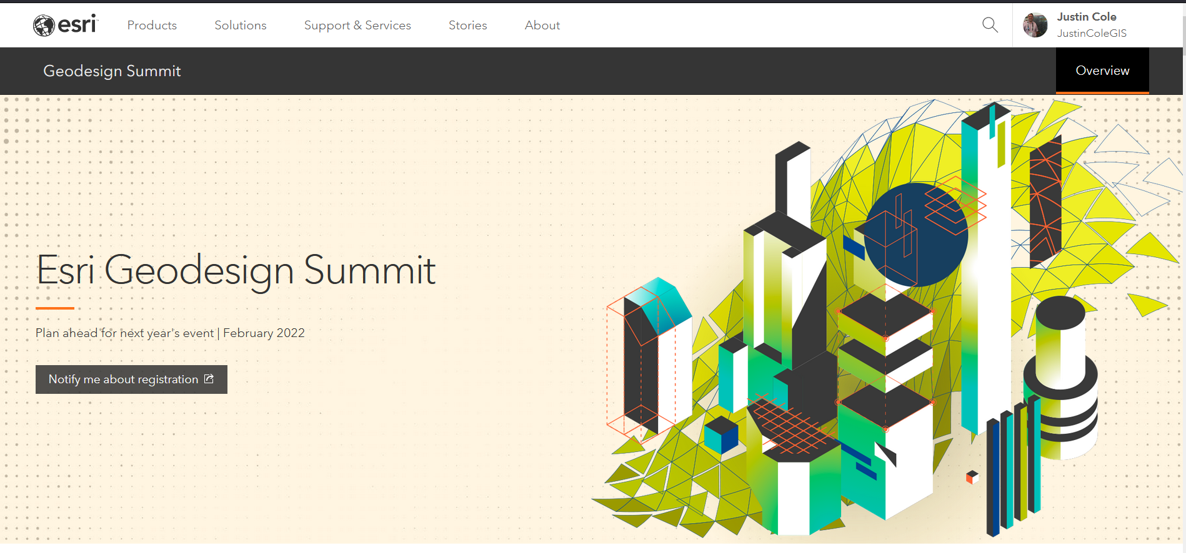
Geodesign Summit

Slide 8
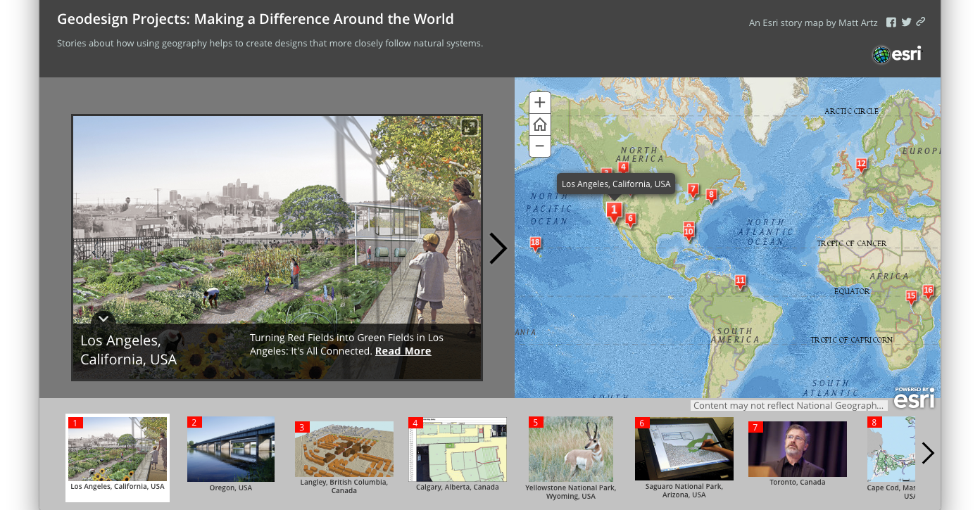
http://bit.ly/GeodesignIGME382

Slide 9
Project
Your Final Grade of the Class is a Final Project (40% of your final Grade)
You can work individually or in pairs
You can do any of the GIS skills we have done in class or have yet to do to solve a problem or explain the world
You will be handing in a story map for your final product

Slide 10
Dates
Proposal Abstract - Due October 21st at 11:59PM
500 Words
Include All Group Members (and all must submit a copy)
Include a brief description and what types of maps you will make (interactive vs static)
Also, make sure to include how you will get your data (sources or create your own)
Final Story Map Due December 9 at Midnight
Make sure your story map stands on its own and does not need any presentation to understand what is going on

Slide 11
Proposal - Abstract
Every proposal should have an abstract. The abstract forms the reader’s initial impression of the work, and therefore plays a big role on whether the application is funded. The abstract speaks for the proposal when it is separated from it, provides the reader with his or her first impression of the request, and, by acting as a summary, frequently provides the reader their last impression. Some reviewers read only the abstract, e.g., a foundation board of directors’ member who votes on final funding decisions. Thus it is the most important single element in the proposal.
To present the essential meaning of the proposal, the abstract should summarize the significance (need) of the work, the hypothesis and major objectives of the project, the procedures to be followed to accomplish the objectives, and the potential impact of the work. Though it appears first, the abstract should be edited last, as a concise summary of the proposal. Length depends on sponsor’s guidelines (from ½ to 2 pages).
Agencies often use the abstract verbatim to disseminate award information.
Updated in 2014 by Christine Black.
Originally produced by Don Thackrey
http://orsp.umich.edu/research-proposals-abstract-or-summary

Slide 12
Discussion Posts
I have setup a discussion board for the projects
If you want to work with others post ideas to share and see if anyone has something you want to collaborate on
For this week I am giving you time to work on ideas and if you want meet with me to bounce ideas

Slide 13
Reminder Midterm Next Class
There is a midterm review slide block in my courses
You can use your notes, software, and slides from class to answer any of the questions
The review will not be available during the test
6 essay questions which focus on your application of the knowledge given so far in class. I recommend giving good detail on why you chose the path you do and you will do well.

